Slide 1
基於分類時頻圖實作簡單語音辨識模型
Keywords: spectrogram, speech recognition, Convolutional Neural Network.
Group Number: 67
Group Members: 潘姵羽 E94064024 工科系
陳品崴 E94066131 工科系
李姵萱 E94061165 工科系
胡家銘 E94066084 工科系
Notes:
Hello everyone, today, I am going to present Faster R-CNN, a fast and high-accuracy of region based detection algorithm.

Slide 2
1. Introduction
Motivation
迎合智慧家電之風潮，希望結合上課所學之深度模型，開發相關功能
Objective
建立可以辨識短指令的模型，並根據辨識結果提供相應的服務
Contribution
整合日常生活常用資訊，完成五種指令辨識(早餐、行事曆、股市、天 氣、幾點)
減少自己查找資料的時間，提升生活效率
Notes:
相信siri
outline

Slide 3
2. Dataset prepare
用同一程式錄製三秒語音指令，錄製後的音檔會進行去雜訊，再繪製成時頻圖等(150*150，RGB) ，共蒐集五個類別的時頻圖，每個類別各400張。
早餐
行事曆
股市
幾點
天氣
recording
preprocess
denoise
draw spectrogram
Notes:
總共4個人，一個人100張，所以一個類別總共是400張

Slide 4
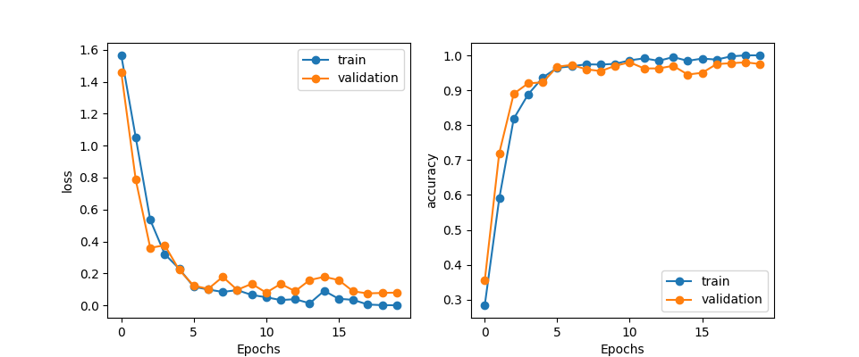
3. Training Process
Loss function: categorical_crossentropy
Optimizer: SGD(lr=0.01, decay=1e-6, momentum=0.9, nesterov=True)
Also use “ReduceLROnPlateau “ to monitor val_accuracy to reduce learning rate
Notes:
The RPN:
The input of RPN is: the images and their feature maps.
The output would be region proposals and their objectness scores. At the last shared layer of initial CNN, a 3x3 sliding window moves across the feature map and maps it to a lower dimension vector (256-d ZF; 512-d VGG, with RELU). (The position of the sliding window provides localization information with reference to the image.)
Let’s take a look at how RPN work:
1) This is sliding window, a sliding window run across the feature maps and will be map with a feature vector.
2) A pre-defined number of anchors are generated at the position of sliding window on the image, which is re-projected from feature map. So we have anchors.
3) At the position of a sliding window, each anchor will be classified and regressed into proposal regions if it possibly contains object based on the feature vectors.
Let’s go to detail.
) Sliding window and low feature vector extraction:
Slide a window (size nxn, ex: n=3) over the convolutional feature map
Map window to a lower-dimensional feature vector (512-d VGG).
The vectors contain the location information on original image. (an receptive field of 228 pixels for VGG)
This process works as a 3x3-kernel convolution with 512 output feature maps
For example: we have 512 60x40 feature maps. Each sliding window run on a feature map (we can assume its size is 3x3x512 when running all feature maps at a time)
We move this sliding window (the yellow area) across the feature maps with stride 1 and using padding 1.
Each position of feature map, we can get a feature vector sized 1 x1x512.
Because using stride 1, we can have 2400 vectors in total.
Each vector contains the location information on original iamge.
Anchor generation:
Anchors:
What are anchors? they are Pre-defined reference boxes that may contain objects in the image. Each set of anchors has multi scales and ratios and has the characteristic of translation invariant. (it means we use the same set of anchors at every location)
How it work? Firstly, we re-project the center of sliding window back to the image. At that position. K anchor boxes are generated. K mean number of maximum possible proposals for each location.
In our case: k = 9 anchors are formed from 3 scales: 128, 256, 512 and 3 ratios: 1:1, 1:2, 2:1
1 sliding window we have 9 anchors. There are totally 60x40x9 = 21600 anchors.
It is recommended that we ignore all cross-boundary anchors. It mean anchors have a part outside the range of image.
We now have 6000 anchors to the next step.
3) Feeding data into Sibling networks:
The data including 2400 vectos and 6000 anchors are fed into the sibling networks:
1) A 1x1-filter regression network (reg). outputs 4 coordinates representing the bounding box of the region.
2) A 1x1-filter classification network (cls). outputs the “objectness” score for that region. (object or no object)
To have more understand let see my picture.
K anchor at a position of sliding window and their corresponding feature vector are fed into 2 sibling networks.
Each anchor will have 2 outputs in classification and 4 outputs in regression. Therefore, k anchors create 2k outputs in classification and 4k outputs in regression.
So how regression and classification work: 1. regression: the object is to compute offsets from anchor boxes using the linear regression method.
X,y now represent center of box; w,h are width and height.
We now have 3 kinds of box: regressed box : notation; anchor box: notation a; and GT box: notation star.
the parameters of box can be regressed using these functions.
In these function i: index of an anchor in a mini-batch.
t_{i}: vector represents 4 parameter of the predicted box.
t_{i}*: the ground-truth box associated with a positive anchor.
After that, we can compute the loss value. In this function: R is robust function (smooth L1)
optimizer要提到learning rate

Slide 5
4. System architecture
使用者先下達語音指令，音檔經過前處理後會生成時頻圖，再將此時頻圖放進訓練好的模型做辨識，程式會根據辨識結果產生對應的動作(例如：若辨識結果為「早餐」，則會用語音告訴使用者早餐該吃哪家店。
speaking
Suggest you where to eat the breakfast
Show the schedule
preprocess
denoise
model predict
Show the stock that you following
Draw spectrogram
Tell you what time it is
Tell you how the weather is

Slide 6
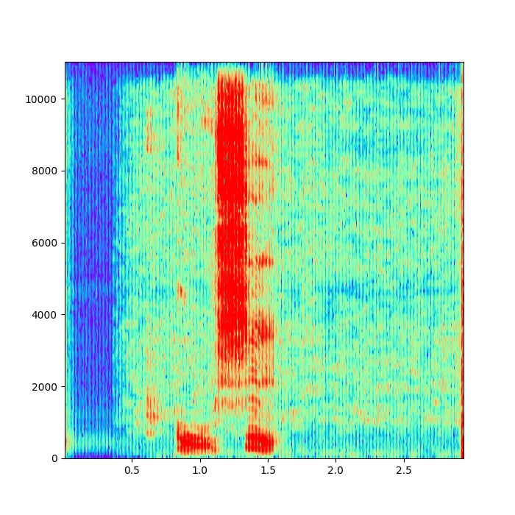
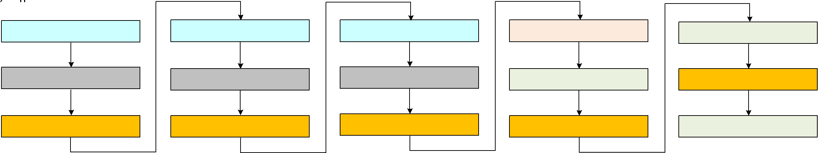
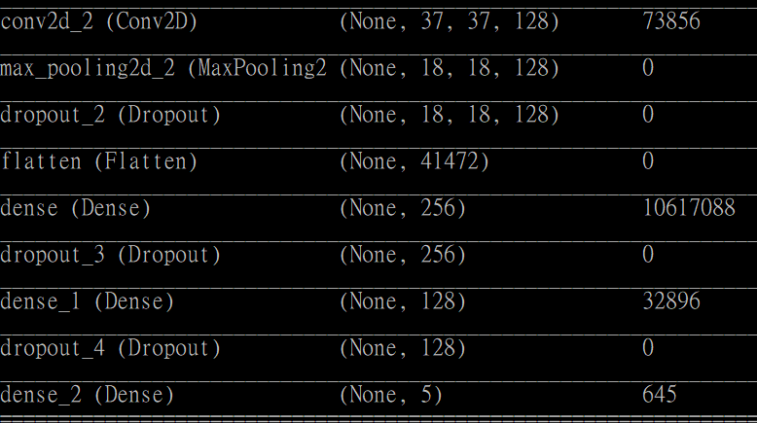
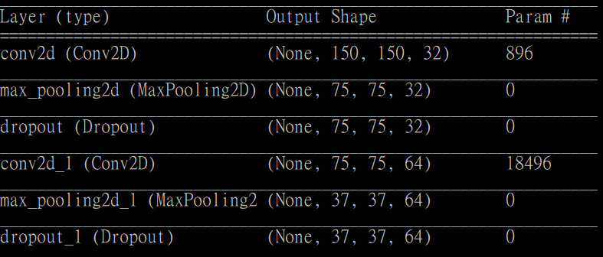
5. Deep Learning Architecture
spectrogram
CNN Model
(150,150,3)
Notes:
2) The next part is feature extraction.
The object is to extract feature maps from the input, which is the image dataset from prior step. The output is feature maps for each image.
The feature maps are extracted by using Deep convolutional network such as VGG16 or ResNet.
For instance, by using VGG16, We only use the feature extraction part of the model until the last convolutional layer. You can see the network in programming on the right side.
we can get 512 smaller feature maps sized 60x40 from each input image sized 1000x600.

Slide 7
6. Present the result
Demo影片連結

Slide 8
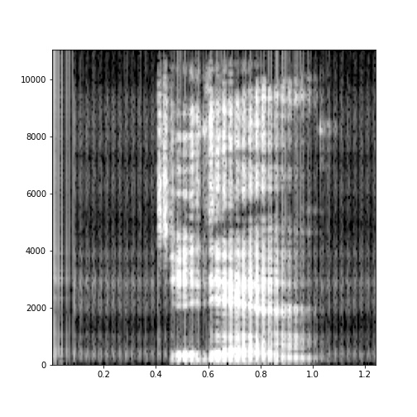
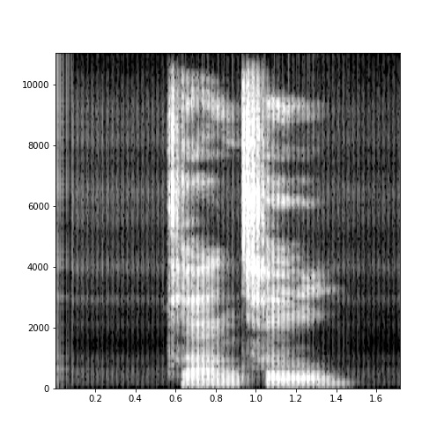
7.1 Previous datasets
未固定錄音長度
幾點
天氣

Slide 9
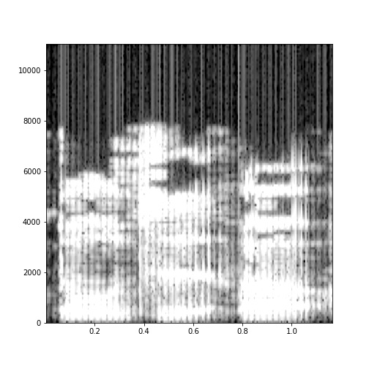
7.1 Previous datasets(cont.)
unknown class
先前有設置未知類別，後來因測試結果不佳，推測是每個人錄製的內容差異很大，所以後來移除此類別
Notes:
原本在類別之中只有三種「幾點天氣和未知」，因為是我們做的是classification，以為除了我們需要完成的服務「幾點、天氣」之外可以將其他事項分類進「未知」，

Slide 10
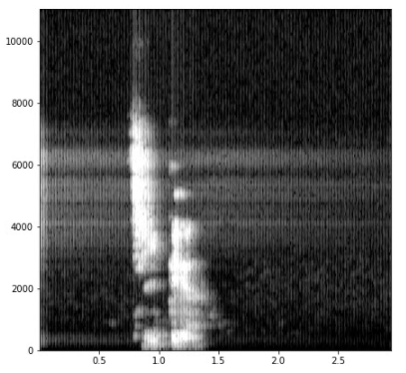
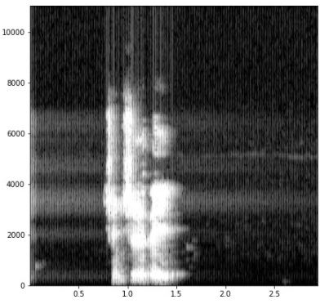
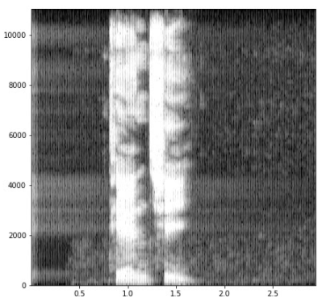
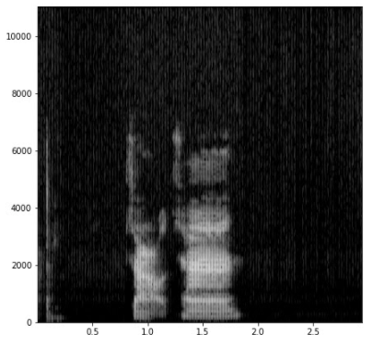
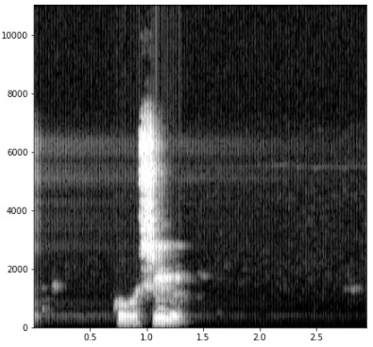
7.1 Previous datasets(cont.)
Gray channel
幾點
行事曆
天氣
早餐
股市

Slide 11
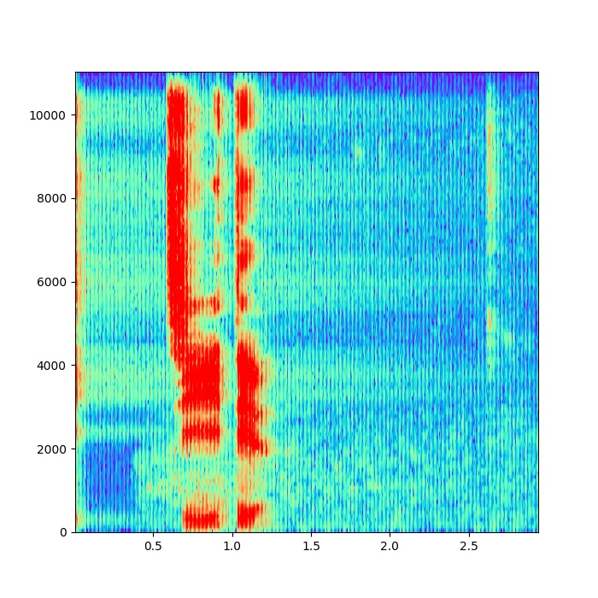
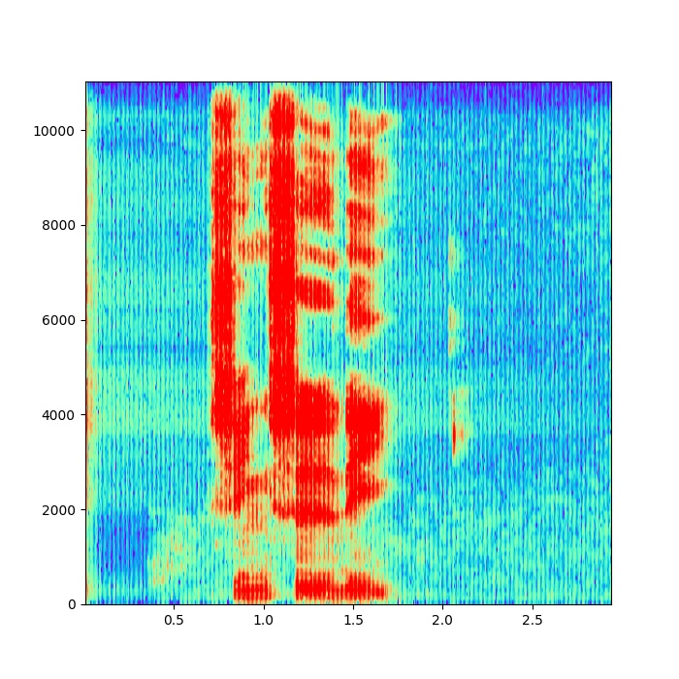
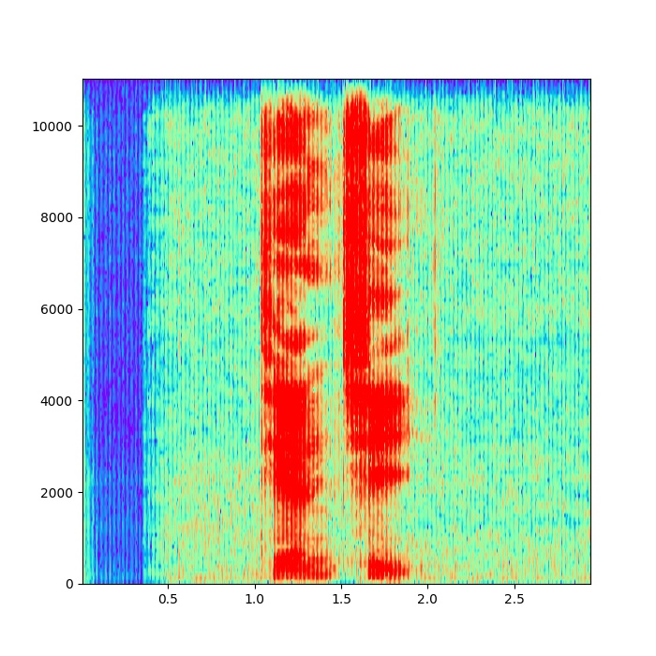
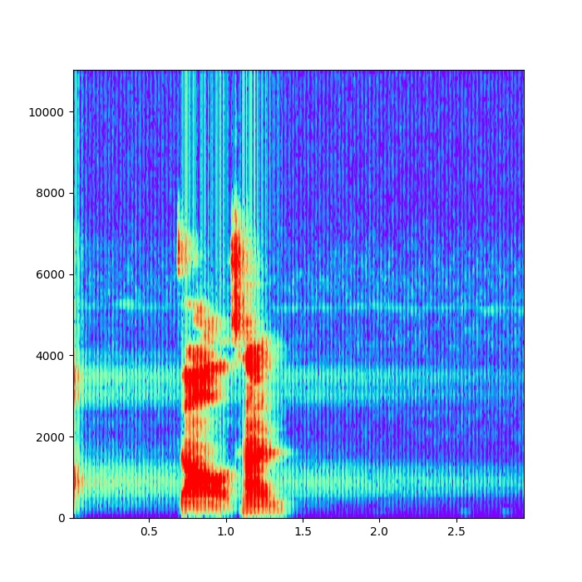
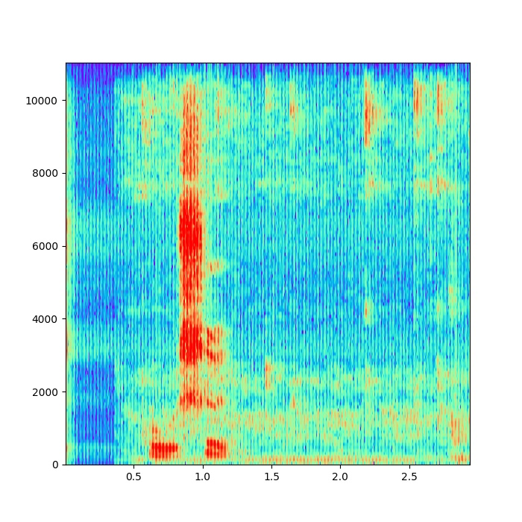
7.2 Experimental Result – Correct Examples
Why is it correct?
股市(test)
幾點(1.14*10^-15)
行事曆(5.77*10^-15)
天氣(7.31*10^-12)
早餐(7.48*10^-11)
股市(1.00)

Slide 12
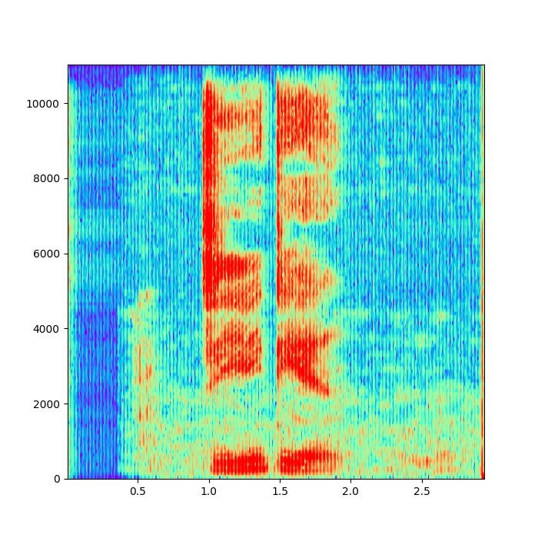
7.3 Experimental Result – Incorrect Examples
Why is it incorrect?
幾點(2.68*10^-7)
行事曆(0.99)
幾點(測試)
天氣(8.47*10^-5)
早餐(6.78*10^-10)
股市(9.77*10^-9)

Slide 13
8. Conclusion
本次專題以CNN完成短指令的語音辨識，但在實作過程中發現，在觀察圖形辨識的結果後，無法得知判斷錯誤的原因，只能大概推測、可解釋度不高，希望未來可朝將模型可解釋化前進
起初沒有統一錄音的時長及裝置，導致訓練時效果不錯但測試錯誤率很高，後來統一時長為3秒，且用電腦執行同一程式錄製dataset，測試正確率有明顯提升，可見資料標準化的重要性
Notes:
增加資料集(數量和資料類別)、固定長度(統一錄製的格式)、灰階，

